Slide 1
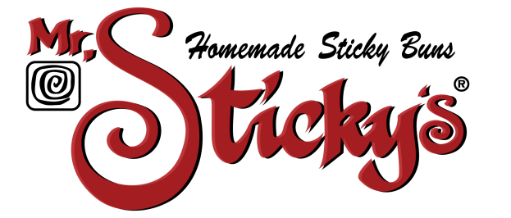
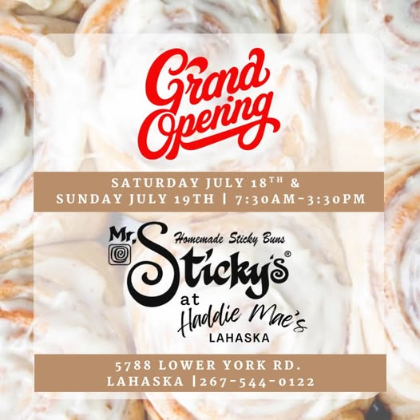
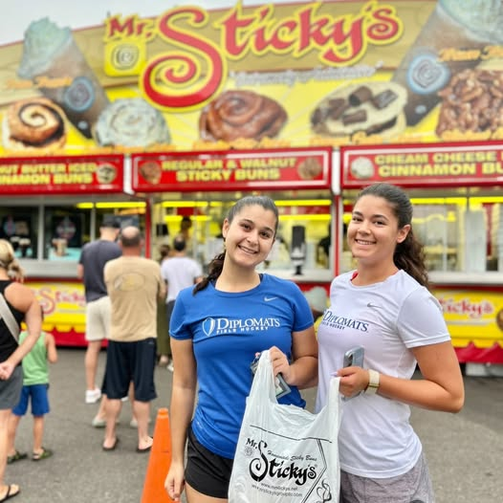
Business Opportunity
Franchise Group LLC.
Voted TOP 10 Sticky and Cinnamon Buns in the United States!
Trip Advisor Hall of Fame Certificate of Excellence 2016-2026
Ranked #1 Bakery - Business Rate Award 2026
READERS’ CHOICE AWARDS 2016-2026
Restaurant Guru Awards 2023-2026
Heard on ESPN Little League World Series!

Slide 2
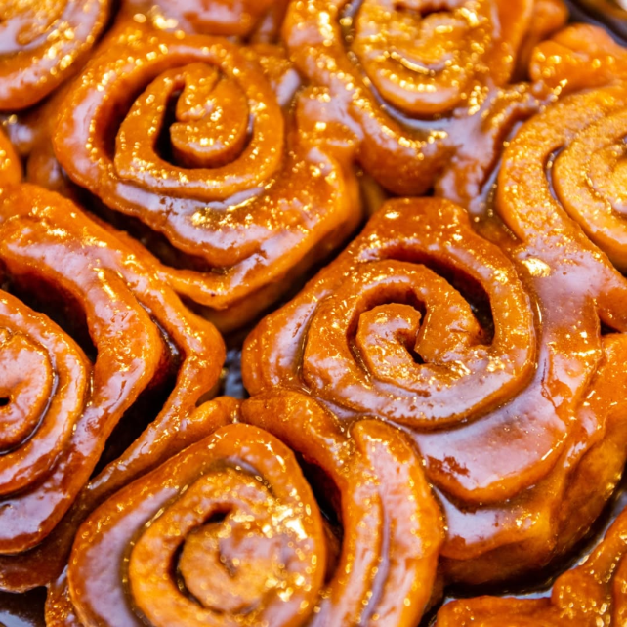
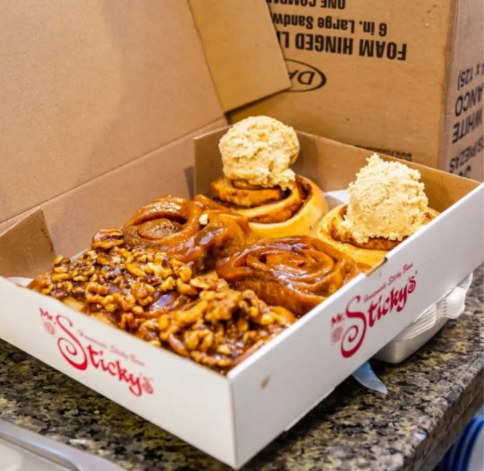
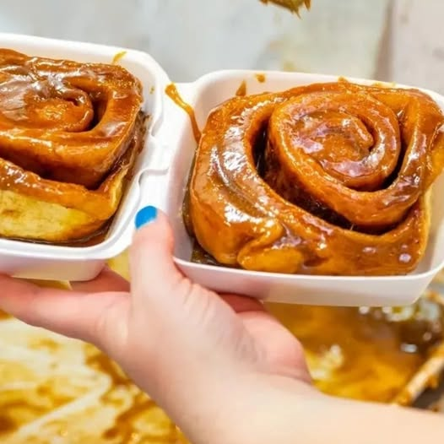
FRANCHISE / LICENSING
Franchise Group LLC.
Who Are We?
Mr. Sticky’s is a Bakery specializing in Scratch Baking (baked fresh daily) Sticky and Cinnamon Buns and other baked wares.
Mr. Sticky’s has been in business for over 25 years. Established in 2001 in Williamsport PA.
Mr. Sticky’s has stand alone locations, restaurants, and full service baking food tractor trailers that tour fairs, carnivals and special events.
Mr. Sticky’s helps non-profits with Fundraisers even on site!
Mr. Sticky’s ships anywhere in the lower 48 States.

Slide 3
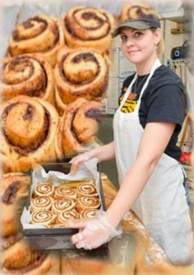
FRANCHISE / LICENSING
Franchise Group LLC.
Since 2019 Mr. Sticky’s has expanded into Super Markets, Stand Alone Baking Sites, Restaurants, and Trailers.
Mr. Sticky’s is an Excellent Business Opportunity for individuals who are financially responsible and capable of satisfying the Mr. Sticky’s franchise fee, equipment costs, store leasing or trailer build and fit out, purveyor product purchasing and staffing of their location.
Mr. Sticky’s is 1/3 to 1/2 LESS than many other franchises making us an opportunity for financial freedom owning your own business that is already established with an excellent name and reputation.
EASY ENTRY
2027/2028 Rates
Our Franchise Fee is discounted to $35,000 paid at the Mr. Sticky’s Franchise Contract settlement - Or - $15,000 for first year and $10,000 per year for four years following.
A 6% Royalty on Monthly Gross (less Taxes)
A 10 year Term
Total Cost
This is determined by your choice of Stand Alone, Restaurant, Drive Thru, or Trailer. You are responsible for your build out. Mr. Sticky’s does not currently do build outs but will assist you to fulfill Mr. Sticky’s requirements for your success. Numbers are given at the moment our Federal Disclosure Document is given to you.

Slide 4
FRANCHISE / LICENSING
Franchise Group LLC.
IDEAL CANDIDATE (S)
Individuals who have scratch baking experience.
Business owners or investors who think LONG TERM and are GROWTH minded in their markets of influence.
Existing Facilities that can handle baking and the correct equipment needed to execute our product.
Individuals who believe in our product and our company ethos.
Why Franchise with Mr. Sticky’s Franchise Group LLC.?
Low Cost Entry = Increased Affordability
Product Variety is based on your ability.
Manageable Daily Inventory = Minimal Cash Flow Demand
Family Friendly Working = Family Life
Mr. Sticky’s used to be open 7 days a week. Here’s what we learned. We experienced high absenteeism, high operational cost; often requiring owners to change their schedule to cover shifts and fill in. This led to burn out, employee churn and unhappy customers. This is why Mr. Sticky’s is now CLOSED on Sundays. Stand Alone Units have not lost business due to Sunday closing. Instead Saturday’s doubled in business. Respect from our customers increased, employee moral increased and absenteeism ended. Mr. Sticky owners had a better work/ family life as well!

Slide 5
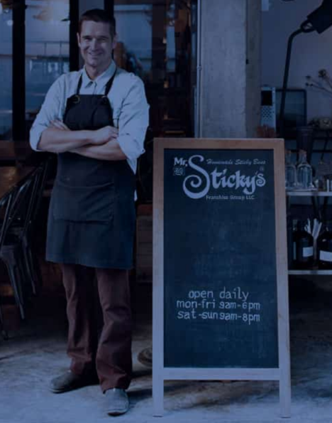
FRANCHISE / LICENSING
Franchise Group LLC.
Why Franchise with Mr. Sticky’s Franchise Group LLC.?
- Continued -
We are dominate with our product, and have many different varieties of that product. As a result, there is minimal waste and will not drain cash flow due to daily made inventory.
Most restaurants have long hours and seven days a week operation that usually requires three shifts for staffing and very little family life. Our Stand Alone Locations operating hour requirements are that you are open Minimally 48-54 hours a week. Example Open Monday-Thursday 7AM-3PM. Friday and Saturday 7AM-4PM. Close Sunday. If you wish to change your hours or expand times - these times are not mandatory.
Kindness and pleasant work environments are essential to success!

Slide 6
What do Customers think about us?
Franchise Group LLC.
We receive THOUSANDS of compliments, so many 5 star reviews and awards but this testimonial that was seen on a public post caught our fancy. Copied WORD for WORD concerning one of our locations.
Alexis G. 8/10/26
A friend heard about my Lancaster Adventure Day informed me that a trip to Lancaster simply would not be complete without a stop at Mr. Sticky’s. Candidly, I had never in my life heard of Mr. Sticky’s. Naturally, I immediately went to the Internet to investigate. Within approximately 30 seconds I had one very important question… HOW HAS THIS AMAZING SUGAR FILLED ESTABLISHMENT ESCAPED MY RADAR FOR ALL THESE YEARS?! Clearly, I had some lost time to make up for. I worked Mr. Sticky's into my adventure, schedule and stop by the Lancaster location shortly after lunch on an early August Thursday. I wasn’t entirely sure what to expect and was pleasantly surprised to find out this cute little building tucked into a shared parking lot with a few picnic tables outside. Even better, there wasn’t anyone in line when I walked up to the window, so there was absolutely nothing standing between me and my impending sugar rush. The menu was shockingly simple and I mean that as a compliment. In a world where I sometimes need 20 minutes and a flow chart to order dessert Mr. Sticky’s basically says, “Here’s the good stuff. Pick one.“ Cinnamon rolls. Regular Sticky’s. Walnut Sticky’s. Iced cinnamon rolls. Regular icing. And… PEANUT BUTTER ICING. Well, hello there! Being myself made of approximately 63.8% peanut butter, there was no way I was leaving without investigating that situation. But I also wanted to try one of their classic Sticky’s so I decided to see if I could break the universe and order a regular sticky with peanut butter icing. Success! Even better, the peanut butter icing came in a little container on the side, allowing me complete control over exactly how ridiculous I wanted this experience to become. I collected my box and headed for one of the picnic tables in the shade. It was approximately 95° outside, so I was grateful for every square inch of shade available. Then I opened the box. The sticky was huge! It was beautifully golden, covered in glistening glaze and smelled absolutely incredible. I was already thrilled, but there was still one very important test standing between Mr. Sticky’s and greatness. The peanut butter icing. Listen, I’m particular about peanut butter icing. If you’re going to invoke the sacred name of peanut butter I need you to COMMIT. I don’t want something light, airy, and vaguely peanut butter adjacent. I want thick. I want rich. I want peanut butter icing that looks me directly in the eyes and says, ”Yeah, I’m peanut butter. What about it?” It was time to find out if Mr. Sticky’s was going to become my future husband. I took one little fork full of the icing by itself. And audibly squealed. Cold. Thick. Rich. Punch –You – In - The – Face peanut butter. Oh yes. Mr. Sticky’s understood the assignment! I knew there was absolutely no chance I was going to finish this enormous sticky in one sitting, so instead of dumping the icing all over it, I went bite by bite. A little sticky. A little peanut butter icing. Repeat until happiness occurs. And happiness absolutely occurred! The sticky itself was soft, sweet and generously, glazed, and adding that ridiculously rich peanut butter icing, pushed the entire thing straight over the edge. Was it incredibly sweet? Yes. Was that a problem? Have we met?! I’m still not sure how I grew up in Central Pennsylvania without Mr. Sticky’s entering my life sooner, but I’m glad somebody finally corrected this terrible oversight. My only complaint is that the closest location is nearly an hour from my house because I can already imagine these becoming a holiday breakfast tradition. Thanksgiving morning with Mr. Sticky’s? Christmas morning with Mr. Sticky’s?! Come on. Holiday made! So, I’m passing along the same advice my friend gave me. If your adventures take you anywhere near Mr. Sticky’s, don’t just consider stopping. Make it a destination. Get the sticky. Get the peanut butter icing. And, maybe don’t make any legally binding, matrimonial decisions until the sugar rush wears off.

Slide 7
Most people are unaware of the expense and cost to start a franchise operation. Shown below are samples (as a comparison) of other franchise business opportunities.*
Franchise Group LLC.
Auntie Anne’s Financial Investment
Initial Investment: $199,475.00 - $638,000.00 Depending on the Venue Type.
Franchise Fee: $35,000.00
Royalty Fee: 7% Monthly
Advertising/ Marketing Fee: 2% to 3% of net sales
Local Marketing Obligation
Financial Requirements:
Liquid Capital:$120,000
Minimum Net Worth: $300,000
(Franchisetimes.com)
Cinnabon Financial Investment
Initial Investment: $247,000 - $675,000.00 Depending on the Venue Type.
Franchise Fee: $35,500.00
Royalty Fee: 6% Monthly
Advertising/ Marketing Fee: 2.5% to 4% of net sales
Financial Requirements:
Liquid Capital:$120,000
Minimum Net Worth: $300,000 to $400,000
(1851 Franchise, Franchise Help)
Dunkin Donuts Financial Investment
Initial Investment: $443,000 - $1,832,500 Depending on the Venue Type.
Franchise Fee: $40,000-$90,000
Royalty Fee: 5.9% Monthly
Advertising/ Marketing Fee: 5% of gross sales
Term: 20 Years
Financial Requirements:
Liquid Capital:$250,000
Minimum Net Worth: $500,000
(Inspire Brands)
Crumbl Cookie Financial Investment
Initial Investment: $367,000 - $1,442,000 Depending on the Venue Type.
Franchise Fee: $50,000.00
Royalty Fee: 8% Monthly
Advertising/ Marketing Fee: 2% of monthly gross sales
Term: 20 Years
Financial Requirements:
Liquid Capital:$200,000
Minimum Net Worth: $500,000
(Crumbl Cookies)
Mr. Sticky’s Financial Investment
Initial Investment: $120,000 - $350,000 Depending on the Venue Type.
Franchise Fee: $35,000.00 at signing
Or Franchise Fee Payment Plan: $15,000 first year $10,000 next 4 yrs. Total: $55,000
Royalty Fee: $1,500 a month or 6% Monthly Gross Sales whichever is greater.
Advertising/ Marketing Fee: 2% of monthly gross sales based on regional market co-operative is active.
Term: 10 Years Renewable
Financial Requirements:
Liquid Capital:$100,000
Minimum Net Worth: $250,000
(MSFG)
*numbers are subject to change without notice. Based on 2026 figures.

Slide 8
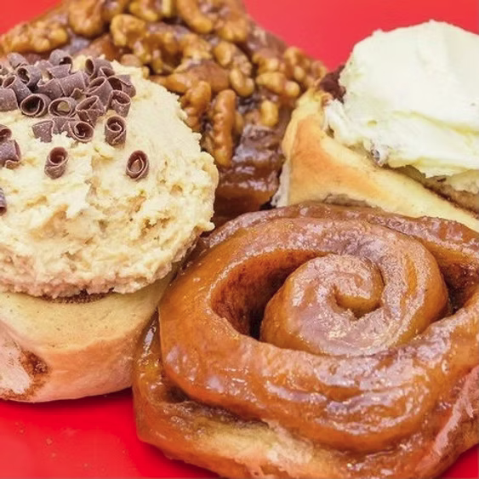
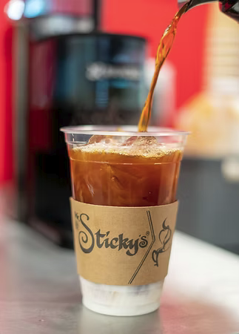
Our Work Environment
Franchise Group LLC.
4-6 Person Staff Daily
Minimum 2 Bakers
Minimum 2 Baristas
Minimum 2 Front counter/ Baristas/Baking Floaters
Stand Alone Units Open 6 days a week Mon-Sat
Opening Menu:
Original Sticky Buns
Cinnamon Buns (Plain)
Cinnamon Buns with Vanilla Cream Cheese Icing
Cinnamon Buns with Peanut Butter Cream Cheese Icing
Walnut Sticky Bun
Raisin Sticky Bun
Specialties of the Month (Sticky and Cinnamon Buns, Icing’s, Drinks)
Eclairs, Cream Puffs

Slide 9
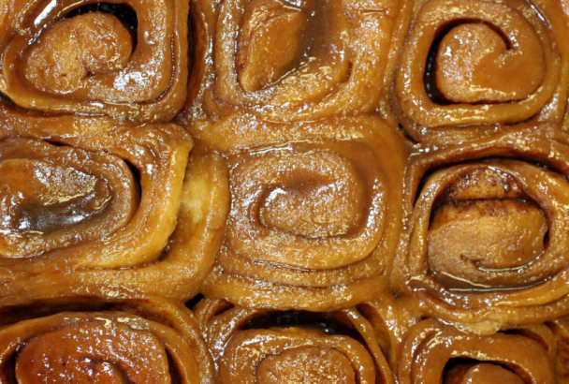
Franchise Group LLC.
Opening in 2026 –
Summer - Lahaska PA,
Fall - Mechanicsburg PA
Opening in 2027:
Winter: Settlement in December of 2026 PA
Fall : Currently Open
Opening 2028
Winter: Currently Open
Fall: Currently Open

Slide 10
Our Process
Franchise Group LLC.
You let us know your interested, leaving your phone number and email address.
Our Representative will call you and speak with you over the phone to answer any immediate questions you may have.
An email with an NDA- Non Disclosure Agreement for will be sent for your review and signature.
A meeting will be had to follow up with our FDD (Federal Disclosure Document) providing you with approximate start-up costs and activities.
Have a series of phone call calls with you to discuss your plans. (time period, financing, location etc.)
Send out and set a settlement date for the Mr. Sticky’s Franchise Agreement.
Discuss any issue with Mr. Sticky’s Franchise Agreement.
Settlement Date.
Future plans are described in the Franchise Agreement and can be discussed after NDA signing. We will be with every step of the process to grand opening and after!
Disclaimer:
This website and the franchise sales information on this site do not represent an offer to sell a franchise. The offer of a franchise can only be made through the delivery of a Federal Disclosure Document (herein the FDD) and finally the Mr. Sticky’s Franchise Agreement. Certain States require that we register the Franchise in those states. We are not directing the communications on this web site to the residents of any of those states. This is a World Wide Web site. Moreover, we will not offer to sell franchises in those states until we have registered the franchise (or obtained an applicable exemption from registration) and delivered the FDD to the prospective franchisee that complies with applicable law.

Slide 11
Contact
Franchise Group LLC.
Robert Winter
Mr. Sticky’s Franchise Group, LLC.
President
Email: robwmrstickys@gmail.com
www.MrStickysgroupllc.com
For more information:
www.MrStickysbuns.com
www.MrStickys.net

